Slide 1
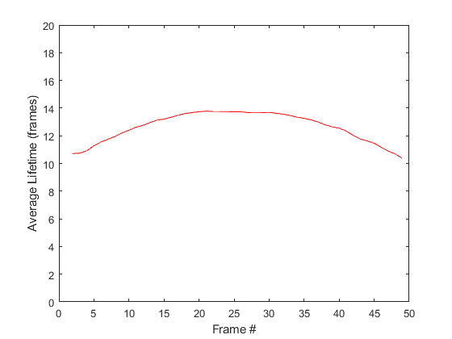
Problem: You’re calculating the average lifetime of all CCSs present at each frame of a movie
At the beginning and end of the movie, some structures are present—you decide to exclude these since you can’t
calculate their lifetime. You get a lifetime vs frame graph like this:
The lifetime at the beginning and end of the movie is artificially lowered because structures of longer lifetime are
more likely to hit the edge of the movie and be excluded by your criterion.

Slide 2
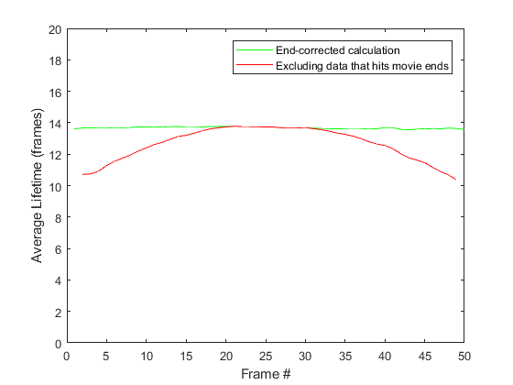
Solution: Lifetime end-correction:
By making some assumptions about the data (see last slides), we are able to correct for this.
To do this, input your data into PlotAverageLifetime with “1,0” as the last 2 parameters.
The data structure this function uses is explained in the comments.
You can convert fxyc structure to this using fxyc2CLT.
See EndCorrectionTest for further implementation details.

